Slide 1
Introduction to R
Jennifer Latessa
Zhiyuan Yao
Richard Johansen
Nov 26th 2019

Slide 2
Workshop Agenda
Workshop Expectations
Why R?
Understanding Data
Data Visualizations in R
Work in R Studio

Slide 3
Workshop Agenda
Workshop Expectations
What is R?
Understanding Data
Data Visualizations in R
Work in R Studio

Slide 4

Expectations
Prerequisites:
R and R studio installed
Goal:
Explore R and R studio environment
Basic functions of R
Import data
Download packages
Simple modeling
Visualize data
Export data and visualization
Caveat
This is only an introduction to the R and R studio environment. Learning a new programming language, like a spoken language, takes years of practice. So we cannot cover everything but we will highlight many common features that most of you will use most of the time.
https://www.visumcx.com/single-post/2017/03/02/The-Value-Of-Setting-Customer-Expectations

Slide 5
Workshop Agenda
Workshop Expectations
What is R?
Understanding Data
Data Visualizations in R
Work in R Studio

Slide 6

What is R?
R is a programming language specifically designed for statistical analysis and graphics
R is free & open-source used in many academic and industry disciplines
R Studio is the Interactive User Interface compatible with R
R and R Studio can be downloaded here:
http://cran.r-project.org/
https://www.rstudio.com/products/RStudio/#Desktop

Slide 7
Why R?
Pros:
Reproducibility
Explicit documentation of steps
Versatile
Run on any operating system
Integrates with other software, languages, and data extensions
Python, Java, SAS, SPSS, Excel
Free and Open-Source w/ large active community
10K+ packages CRAN, Twitter, GitHub, etc.
Comprehensive
Eliminates the need for multiple software
GIS, Excel, ENVI, etc.
Computationally Robust
Fast and allows for high level analysis
Cons:
Steep Learning Curve
Requires a significant time investment especially starting with little to no coding experience
Limited “Point & Click”
R Commander or Radiant?
Open-Source
Rely on creators to follow coding etiquette
Version control and instability

Slide 8
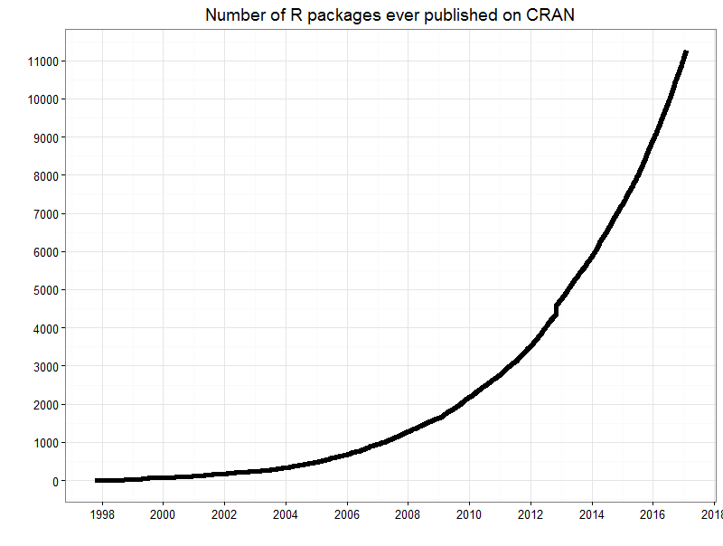
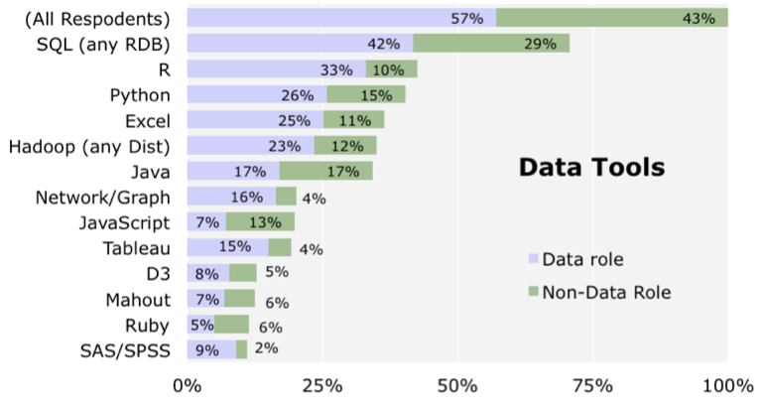
Why R?
Increasing in Popularity (especially in academia)
User contributions significantly increased over the last decade
http://blog.revolutionanalytics.com/2014/01/in-data-scientist-survey-r-is-the-most-used-tool-other-than-databases.html
http://blog.revolutionanalytics.com/2016/03/16-years-of-r-history.html

Slide 9
Workshop Agenda
Workshop Expectations
What is R?
Understanding Data
Data Visualizations in R
Work in R Studio

Slide 10
What is Data?
Data is a collection of objects defined by attributes
An attribute is a property or characteristic of an object
Examples: eye color of a person, temperature, etc.
Synonyms: Columns, variables, fields, characteristics, features, etc.
An object is the phenomena being described or evaluated
Examples: Bob/Sarah, house, substance, etc.
Synonyms: Rows, records, points, cases, samples, instances, etc.

Slide 11
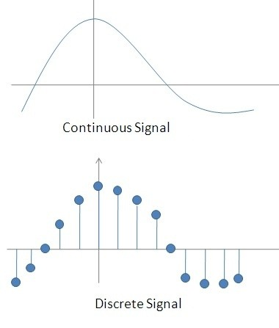
Attribute Classification
Discrete Attribute – has a countable set of values
Examples: zip codes, number of words,
Typically represented as integers
Continuous Attribute - has an infinite set of numbers and potential divisions
Example: temperature, height, weight
Typically represented as floating point (decimal)
https://qph.fs.quoracdn.net/main-qimg-7badb966d5ff6063ddb515737011ed1b-c

Slide 12
Important Attribute Classes
Categorical
Nominal - Data that can be counted, but not aggregated or ordered
Examples: Eye Color, Zip Code, Music Genre
Ordinal - Data that can be counted and ordered, but not aggregated.
Examples: Grades, Clothing Size, Positions (in a race)
Numerical
Interval (metrics) - The difference in values are constant and meaningful
Examples: The difference between a temperature of 100°F and 90°F is the same difference as between 90°F and 80°F.
Ratio - An interval scale with an absolute zero
Examples: Income, Height, Weight

Slide 13
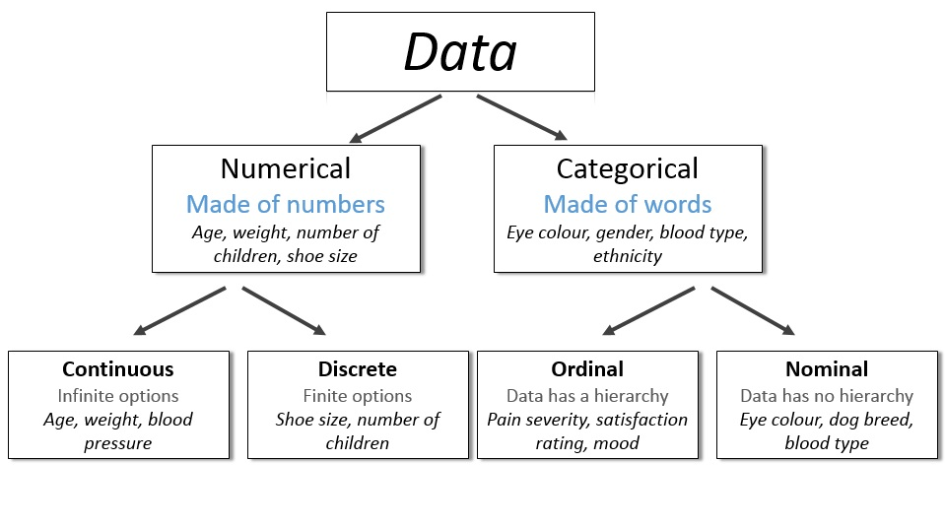
http://survivestatistics.com/variables/

Slide 14
Primitive Data Types (Computer Language Data Types)
Boolean:
True (T) or False (F)
Char:
Characters and Strings – “A”, “Beta”, “There are different data types!”
Int:
Integers – (1, 2, 100)
Float/Double:
Decimal – (0.1, 0.2, 0.1352)

Slide 15
Data types in R
R has a wide variety of data types including scalars, vectors (numerical, character, logical), matrices, data frames, and lists.
Vector
a <- c(1,2,5.3,6,-2,4) # numeric vector
b <- c("one","two","three") # character vector
c <- c(TRUE,TRUE,TRUE,FALSE,TRUE,FALSE) #logical vector
Refer to elements of a vector using subscripts.
a[c(2,4)] # 2nd and 4th elements of vector

Slide 16
Data types in R
Matrices
mymatrix <- matrix(vector, nrow=r, ncol=c, byrow=FALSE,
dimnames=list(char_vector_rownames, char_vector_colnames))
byrow=TRUE indicates that the matrix should be filled by rows. byrow=FALSE indicates that the matrix should be filled by columns (the default). dimnames provides optional labels for the columns and rows.
# generates 5 x 4 numeric matrix y<-matrix(1:20, nrow=5,ncol=4) # another example cells <- c(1,26,24,68) rnames <- c("R1", "R2") cnames <- c("C1", "C2") mymatrix <- matrix(cells, nrow=2, ncol=2, byrow=TRUE, dimnames=list(rnames, cnames))

Slide 17
Data types in R
x[,4] # 4th column of matrix
x[3,] # 3rd row of matrix
x[2:4,1:3] # rows 2,3,4 of columns 1,2,3
Arrays
Arrays are similar to matrices but can have more than two dimensions. See help(array) for details.

Slide 18
Data types in R
Data Frames
A data frame is more general than a matrix, in that different columns can have different modes (numeric, character, factor, etc.). This is similar to SAS and SPSS datasets.
d <- c(1,2,3,4)
e <- c("red", "white", "red", NA)
f <- c(TRUE,TRUE,TRUE,FALSE)
mydata <- data.frame(d,e,f)
names(mydata) <- c("ID","Color","Passed") # variable names
There are a variety of ways to identify the elements of a data frame.
myframe[3:5] # columns 3,4,5 of data frame myframe[c("ID","Age")] # columns ID and Age from data frame myframe$X1 # variable x1 in the data frame

Slide 19
Data types in R
Lists
An ordered collection of objects (components). A list allows you to gather a variety of (possibly unrelated) objects under one name.
# example of a list with 4 components -
# a string, a numeric vector, a matrix, and a scaler
w <- list(name="Fred", mynumbers=a, mymatrix=y, age=5.3)
# example of a list containing two lists
v <- c(list1,list2)
Identify elements of a list using the [[]] convention.
mylist[[2]] # 2nd component of the list
mylist[["mynumbers"]] # component named mynumbers in list

Slide 20
Data types in R
Factors
Tell R that a variable is nominal by making it a factor. The factor stores the nominal values as a vector of integers in the range [ 1... k ] (where k is the number of unique values in the nominal variable), and an internal vector of character strings (the original values) mapped to these integers.
# variable gender with 20 "male" entries and
# 30 "female" entries
gender <- c(rep("male",20), rep("female", 30))
gender <- factor(gender)
# stores gender as 20 1s and 30 2s and associates
# 1=female, 2=male internally (alphabetically)
# R now treats gender as a nominal variable
summary(gender)
An ordered factor is used to represent an ordinal variable.
# variable rating coded as "large", "medium", "small' rating <- ordered(rating) # recodes rating to 1,2,3 and associates # 1=large, 2=medium, 3=small internally # R now treats rating as ordinal

Slide 21
Data types in R
Other useful functions
length(object) # number of elements or components
str(object) # structure of an object
class(object) # class or type of an object
names(object) # names
c(object,object,...) # combine objects into a vector
cbind(object, object, ...) # combine objects as columns
rbind(object, object, ...) # combine objects as rows
object # prints the object
ls() # list current objects
rm(object) # delete an object
newobject <- edit(object) # edit copy and save as newobject
fix(object) # edit in place
https://www.statmethods.net/input/datatypes.html

Slide 22
Workshop Agenda
Workshop Expectations
What is R?
Understanding Data
Data Visualizations in R
Work in R Studio

Slide 23
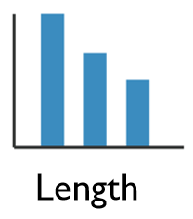
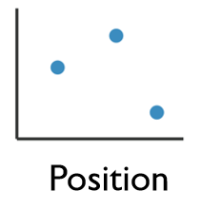
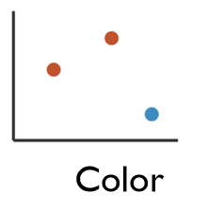
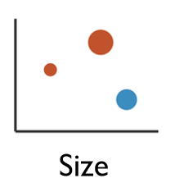
Enhancing Visualizations
1 Dimensional Data
Length
2 Dimensional Data
Position
2+ Dimensional Data
Position
Color Hue/Saturation
Size
Shape

Slide 24
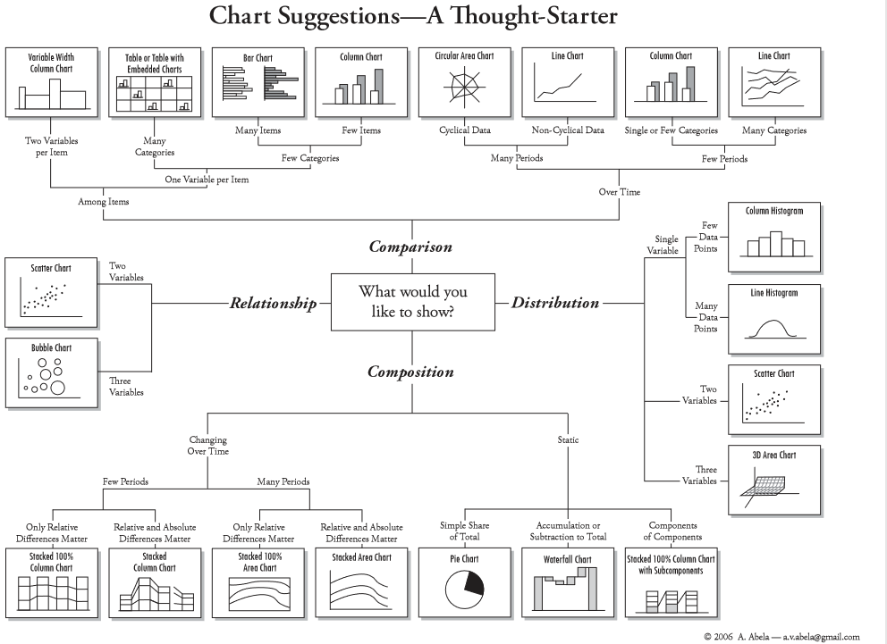
Four Basic Chart Types
http://extremepresentation.typepad.com/files/choosing-a-good-chart-09.pdf

Slide 25
Grammar of Graphics
Originated by Leland Wilkinson, simplified by Hadley Wickham and others.
Data – The raw materials of your visualization
Layers – What you actually see on the plot (plots,lines,etc.)
Scales – Maps the data to grpahical output
Coordinates – The visualization’s perspective (normally a grid)
Faceting – Provides details into the data (analoguous to pivot tables)
Themes – Control the details of the display (color scheme, fonts)
http://vita.had.co.nz/papers/layered-grammar.pdf
Notes:
Alison

Slide 26
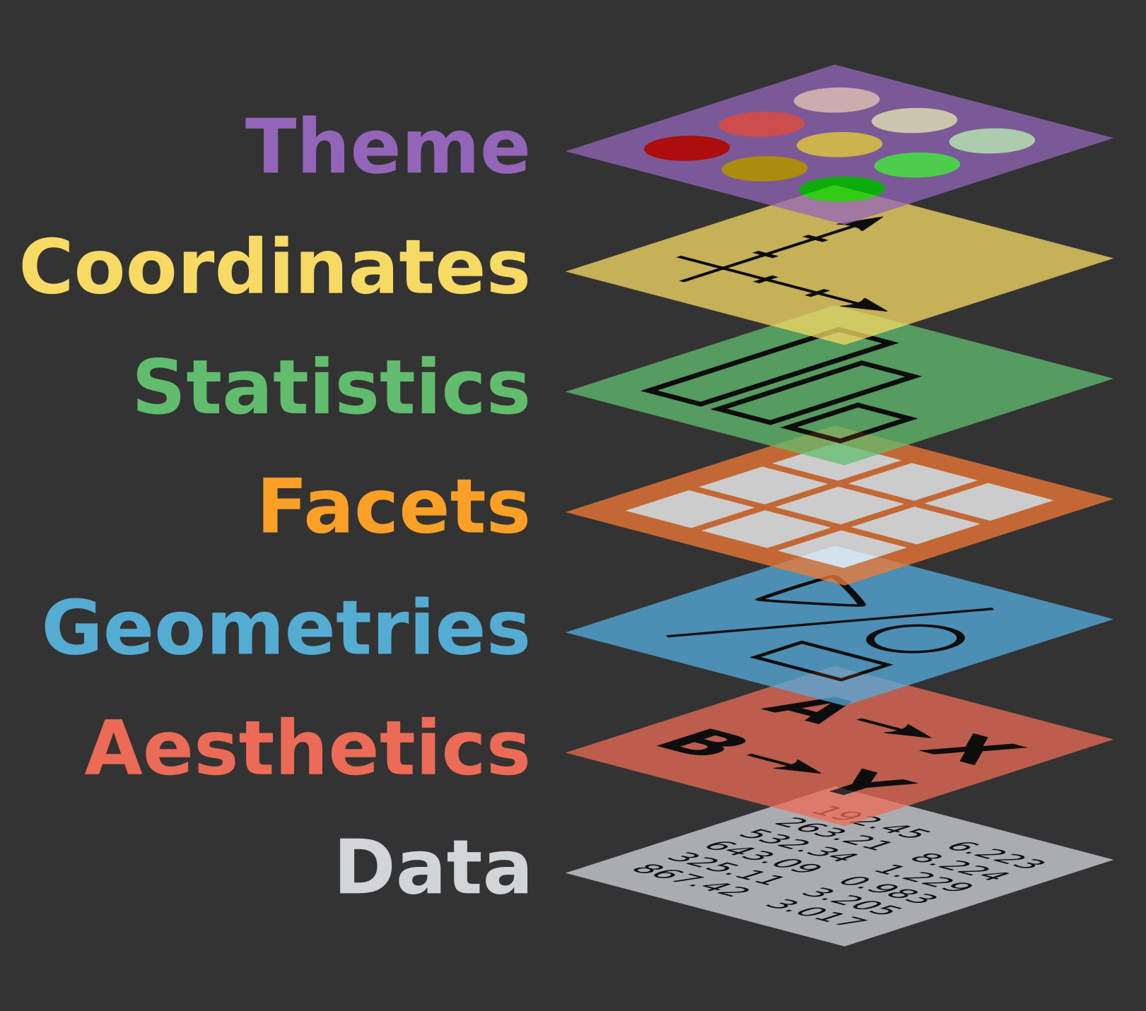
Grammar of Graphics
Describe all the non-data ink
Plotting space for the data
Statistical models & summaries
Rows and columns of sub-plots
Shapes used to represent the data
Scales onto which data is mapped
The actual variables to be plotted

Slide 27
The Basics
Data – The raw materials of your visualization
Aesthetics – The mapping of your data to the visualization
X-axis is age
Y-axis is survival
Layers – Any visualization requires at least one layer and in ggplot2 these are typically the geoms.
Example a barchart is geom_bar()

Slide 28
Want to continue learning R?
Academic Courses:
CS 2005C – Introduction to Programming for Informatics with Python and R
BE 8083 – Data Analysis with R and SAS
BANA 5143 – Statistical Computing
PH 7011 – Statistical Computation and Software
Lynda (Many free courses):
Learning R
Data Wrangling with R
R Statistics Essential Training
Library Workshops:
https://webapps2.uc.edu/ce/facdev/Workshops

Slide 29
Online Help/Resources
Google!
www.YouTube.com
www.stackoverflow.com
www.r-bloggers.com
Twitter: #rstats

Slide 30
Contact Research & Data Services West
Email: AskData@uc.edu
Web: https://libraries.uc.edu/digital-scholarship/data-services.html
Visit: 240 Braunstein Hall (Geology-Math-Physics Library)
Consultations: walk-ins during open consultation hours or appointment by email
Twitter: @DataVizJohansen

